Slide 1
Supervised Non-negative Matrix Factorization for Audio Source Separation
Hoang Mai, Tom Zhou, Alex Violet
Notes:
Outline
How to represent audio
Representation as NMF
Experimentation: things we tried
Why we chose implementation
Algorithm
Finding B
Finding W
Recovery (wiener)
Proof
Results
Limitations
Sources

Slide 2
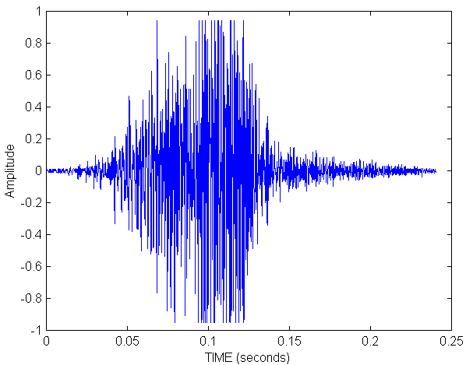
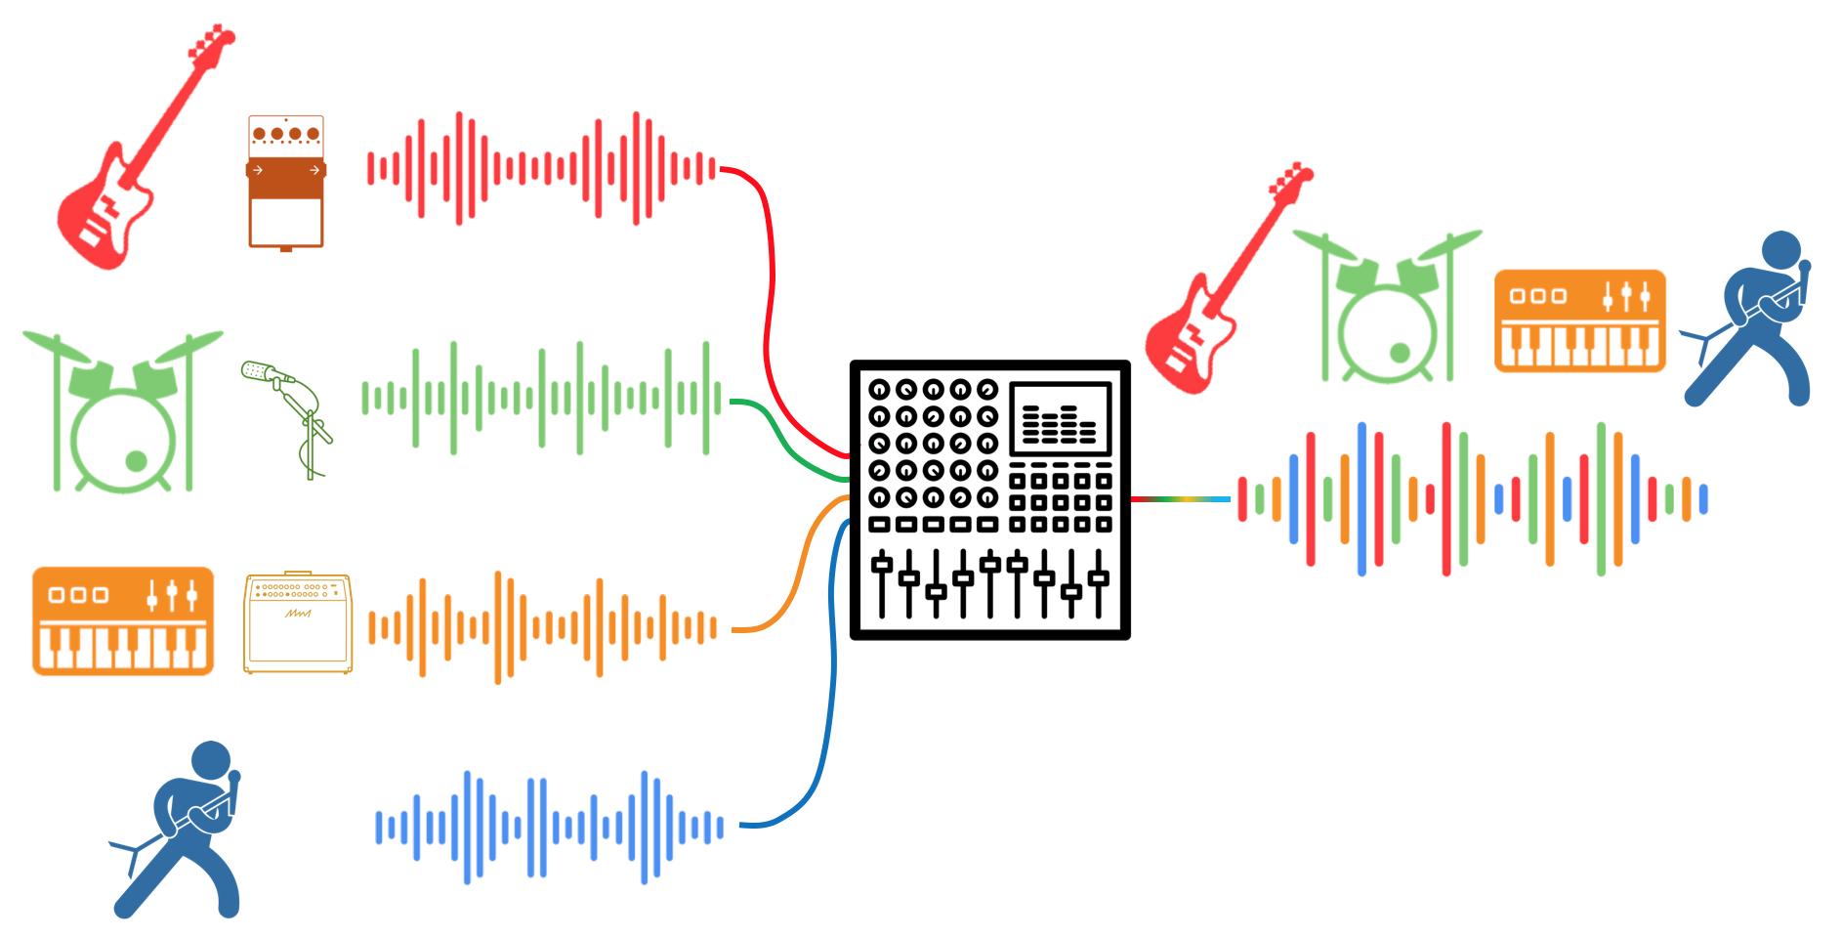
Background & Context
Notes:
Sound we hear comes from various sources
different sounds in a band
birds, cars, background noise, etc
We only receive it as a summation of all these different signals
Alex

Slide 3
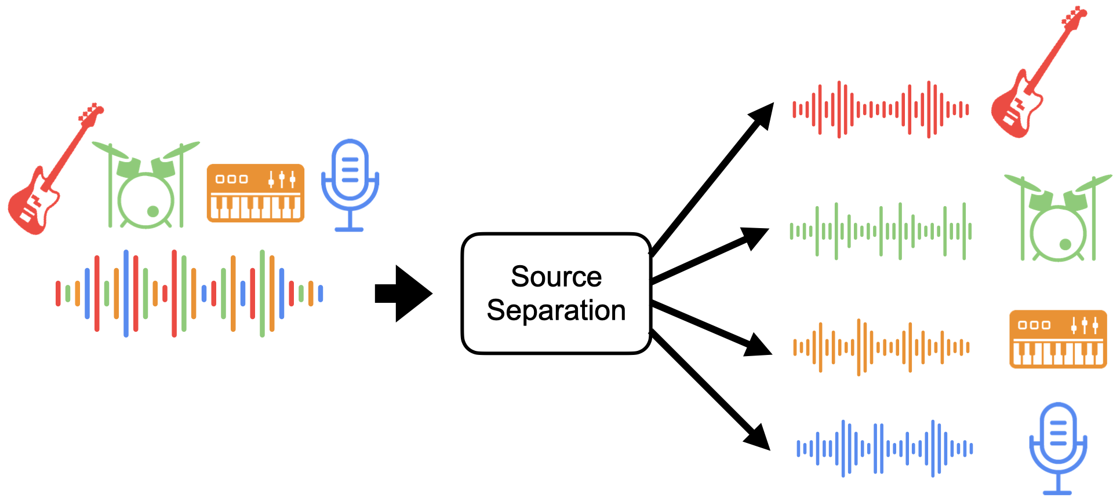
Foundational NMF and Audio Representation
Notes:
Audio separation is desirable
Applications include:
filtering (like background noise)
isolation for hearing aids
enhancing voice commands
transcription
etc
Hoang

Slide 4
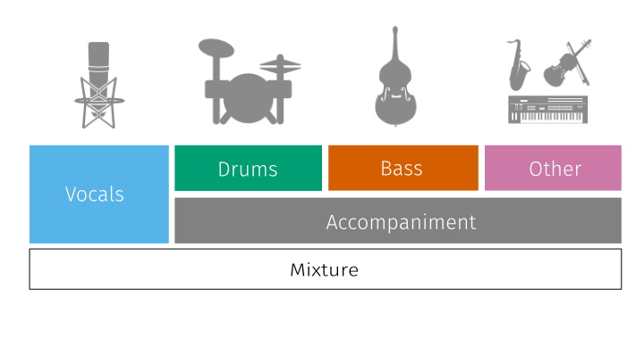
Data
MUSDB18 Library:
150 songs
4 Classifications
Notes:
Explain Data (self explanatory)
Tom

Slide 5
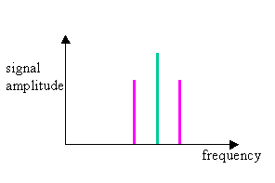
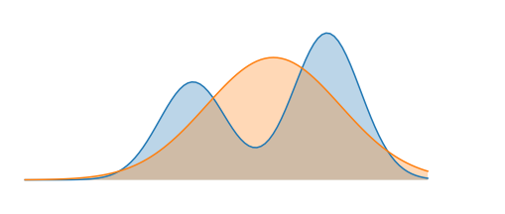
NMF and Audio Representation
Time vs. Amplitude Domain → Magnitude Spectrograms
ensures non-negativity
via Short-Time Fourier Transform
Switch from Euclidean Distance to Kullback–Leibler (KL) divergence
KL’s scale-invariant properties are better for audio
Unlike Euclidean distance, which assumes Gaussian noise
q
p
Notes:
NMF: great, but must adhere to its constraints
Change audio representation for non negativity constraint
time domain could result in negative amplitudes / representations
Why we switch to KL
Evidence showing it’s better for audio perceptions
Not linear additive → logarithmic additive (don’t worry about it too much, but just in case they ask questions)
Alex

Slide 6
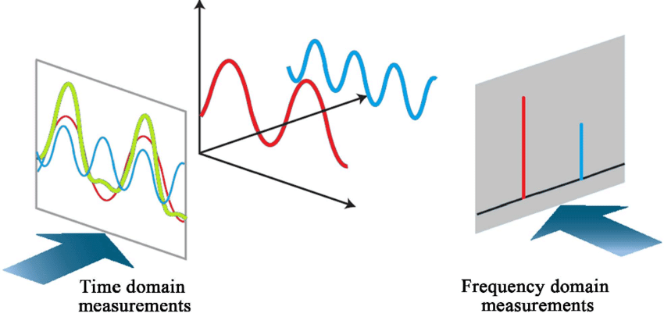
Short Time Fourier Transform
Notes:
BRIEFLY EXPLAIN WHAT FOURIER TRANSFORMS ARE AND WHAT SHORT TIME FOURIER TRANSFORM IS (this isn’t the topic of our presentation this time)
STFT, transform audio from being represented by amplitude vs time -> Frequency vs Time.
Specifically STFT, it chops an audio signal into small windows with a arbitrary amount of overlap(for smooth). In the frequency domain, we can manipulate audio and we will be working on source separation there.
Note that STFT is just an algorithm to solve the fourier transform problem as quickly as possible that is context aware which is great for songs and our goals.
Alex

Slide 7
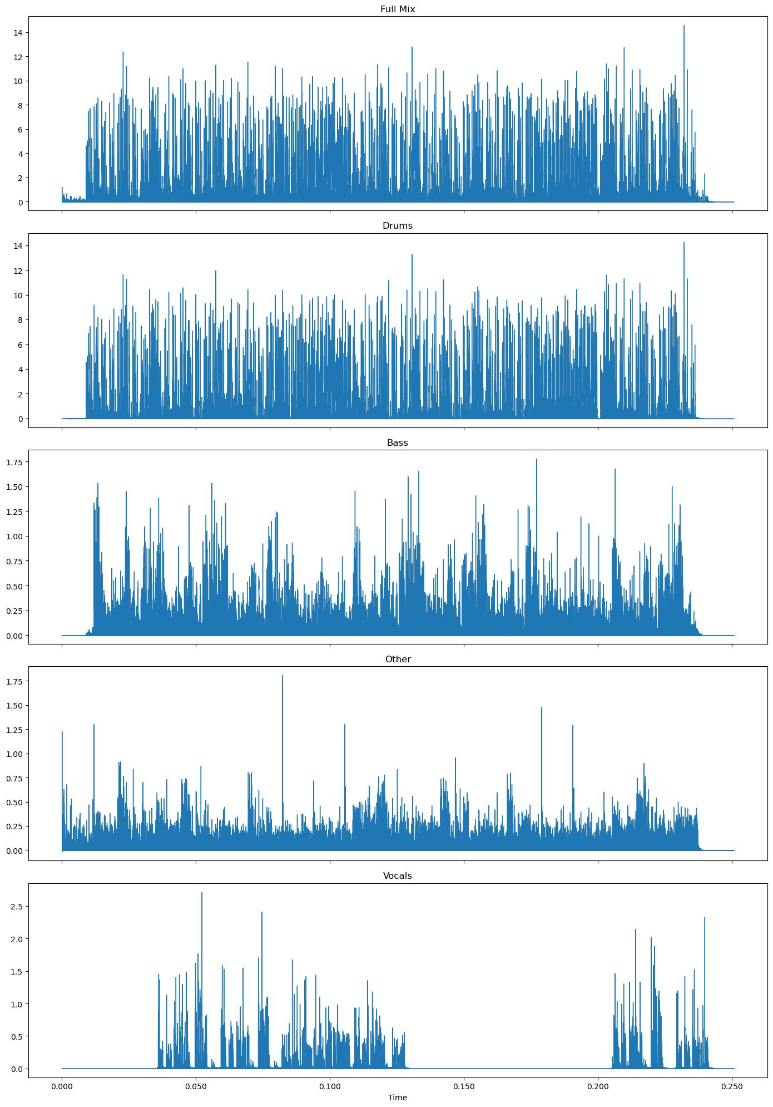
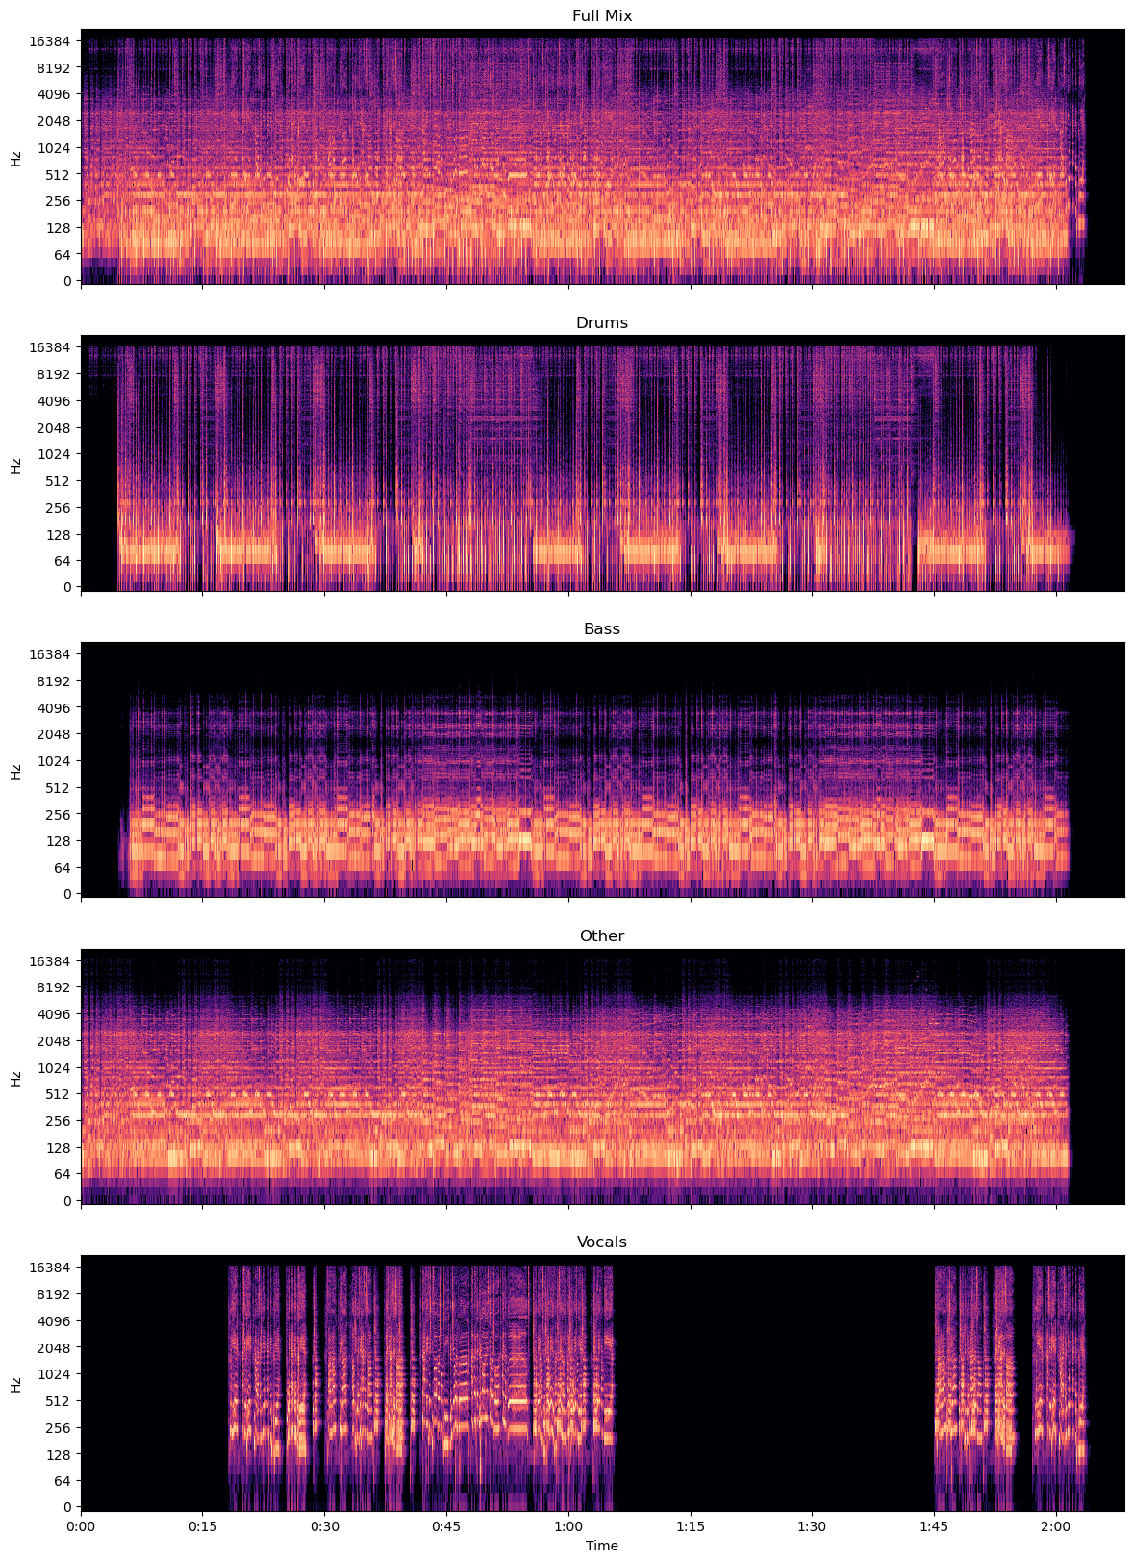
Notes:
Cool Visuals
Alex

Slide 8
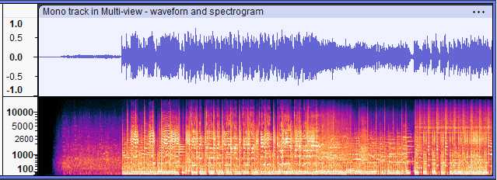
Weakness of Regular NMF
KL-NMF fails to capture key aspects of music alone
treats each tight frame as an independent observation
ignores highly correlated nature of music
Results in unstable activation weights or robotic sounding music
Notes:
Songs are NOT independent
Continuous stream of sounds
Usually in the same key
Cycles like chorus, verses, same instruments, same type of voice, etc
Hoang

Slide 9
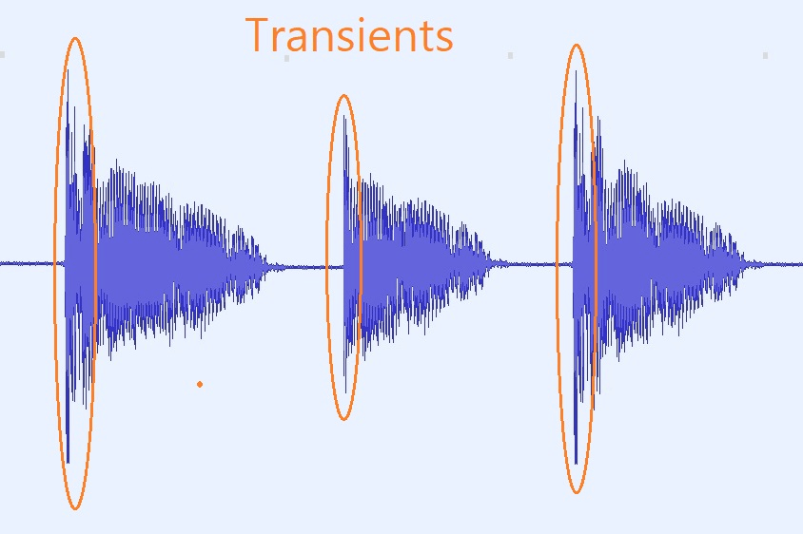
Possible Solutions to Independence Problem
Cost of Uniform Application
Adding temporal continuity cost
Transient Instruments (eg: drums) L₁ minimization
Apply same regularization across all instruments
Results in degradation of separation quality
vocals get collapsed under penalties
energy leakage to unpenalized portions of basis matrix
Notes:
DEFINE Transient: last a short period of time
L1 makes sense since we want to eliminate features rather than flatten and add too many like L2 minimization
Uniform application is problematic because different instruments sound different
Hoang

Slide 10
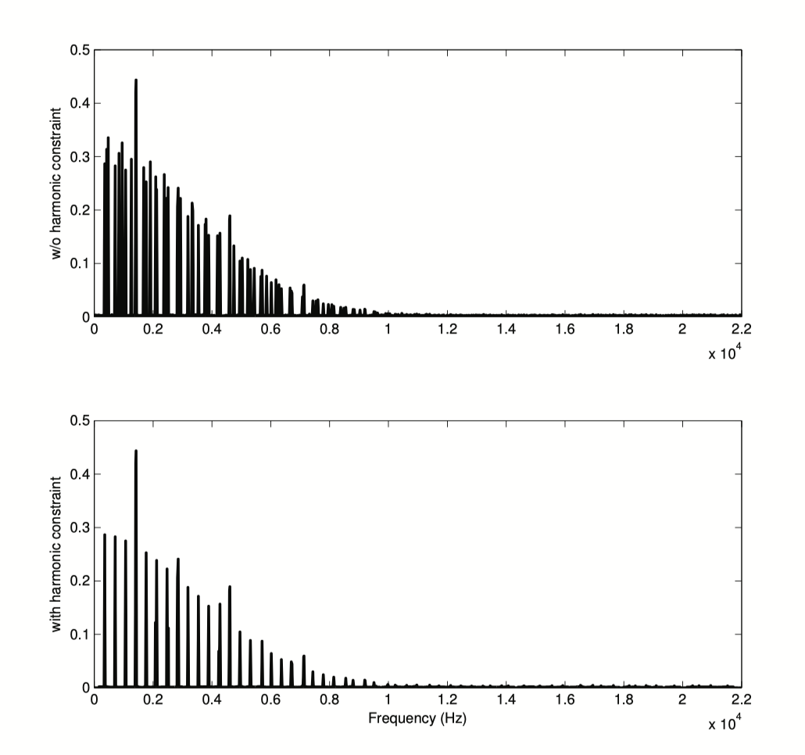
Our Experimentations
Modified Tjoa’s HARMONIC VARIABLE-SIZE DICTIONARY LEARNING
Two layered dictionary
Utilize K-SVD to + comb filtering to enforce harmonic constraints
Atom made out of 1 pitch /Atom
Layer 1: single pure frequency + their overtones
Layer 2: MFCC Coefficient of layer 1
MFCC (Mel Frequency Cepstral Coefficient)
Typical 14-20 coefficients that describes a sound’s Spectral Envelope, or timbre.
Notes:
We experimented with Tjoa’s Algorithm that learns an dictionary of atoms being made up of a single pure frequency + their overtones. This was inspired by the problem of solving source separation problems of having multiple instrument playing different parts at the exact same time. When occurs in music in forms like unison melodies. Currently is outside of the scope because of the composition of sound requires soft and probabilistic assignments to perform well.
Tom

Slide 11
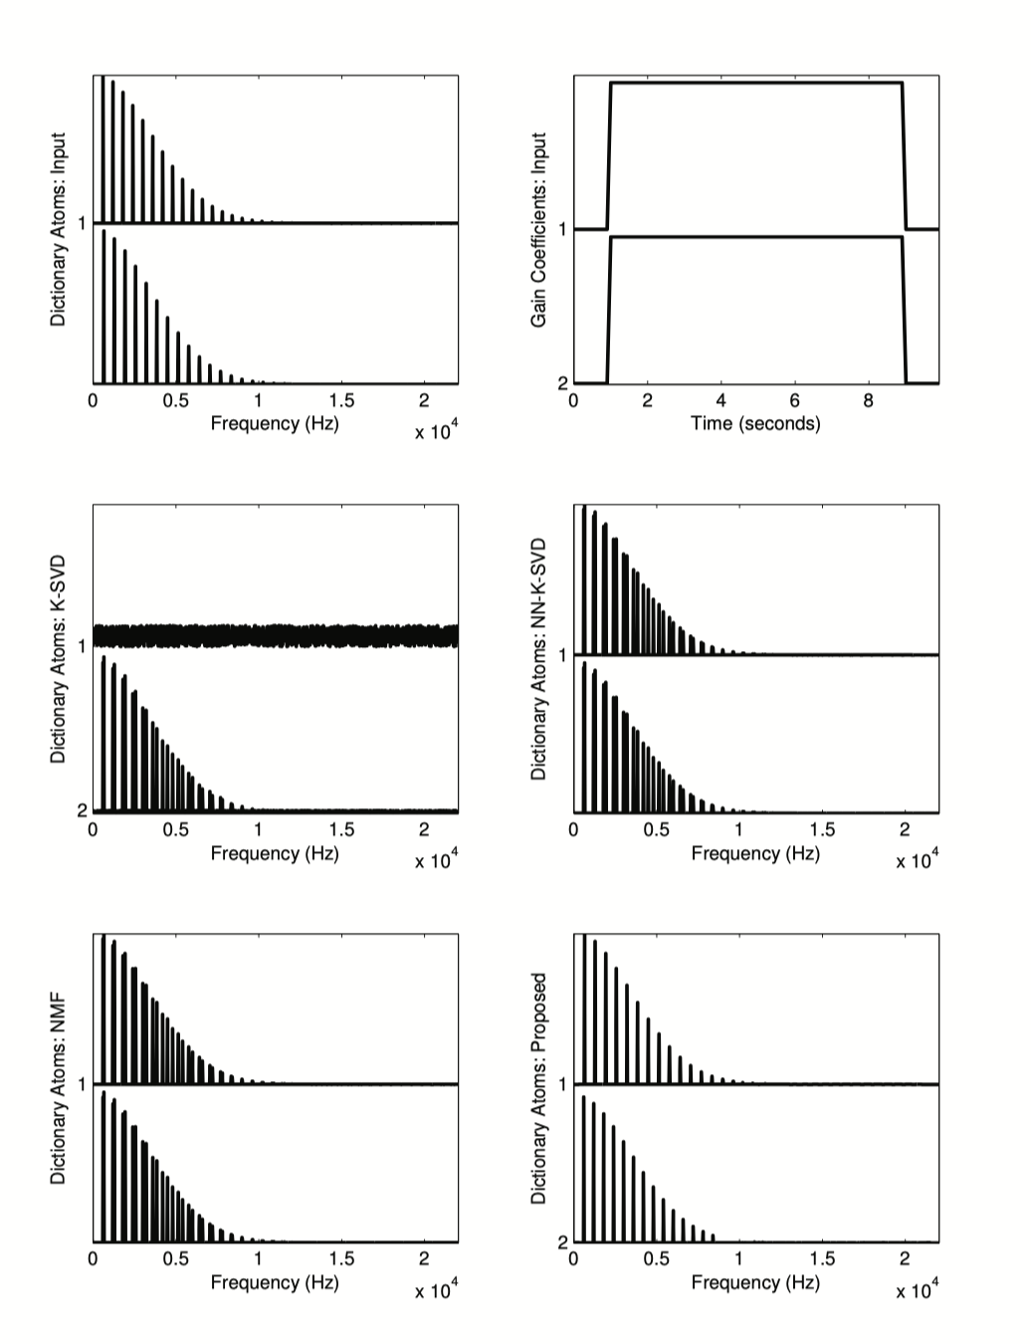
Our Experimentation cont.
Motivation
Separate instruments playing identical notes simultaneous
Differentiate by timbre when pitche alone fails.
Key Limitation
MFCC requires temporal context to be useful
Single-frame atom lacks interpretable timbre information.
Tjoa’s dictionary requires shared assignments with soft/probabilistic assignments.
Notes:
Tom

Slide 12
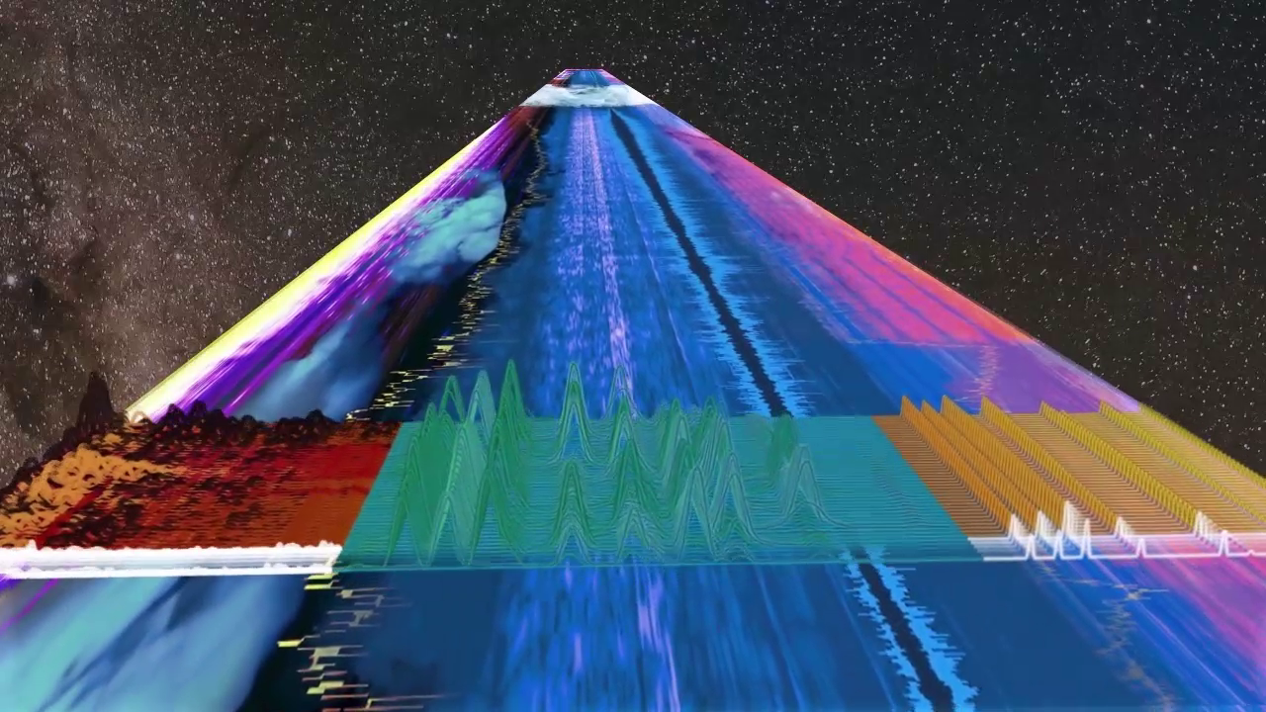
OUR APPROACH
Notes:
Tom

Slide 13
Intuition:
instrument-specific, decoupled regularization for their properties
conceptual reasoning:
drums transients are fast, abrupt and loud
bass is low frequency and often continuous.
vocals have a ton of variability in texture and timbre
other is complex and lots of variations
Notes:
set up our approach:
we’re in a specific niche
we can tailor our approach
Alex

Slide 14
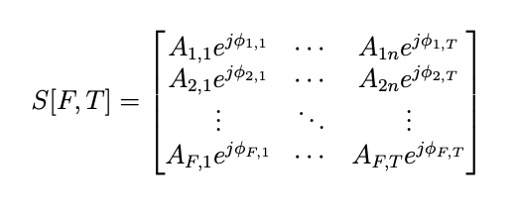
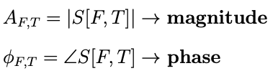
Decoupling NMF for Source Separation
Data Representation for NMF’s Structure:
Convert time-domain audio to time-frequency with Short-Time Fourier Transform
Notes:
Satisfies non-negativity constraint
This is just preparing our audio data in a way NMF can utilize
Notation:
F is number of frequency bins
T is number of time frames
This is just fourier transform notation
Alex

Slide 15
Decoupling NMF for Source Separation
Data Representation for NMF’s Structure:
V is original magnitude of spectrogram
B is basis matrix
W is weight matrix
V ≈ BW
Notes:
explain notation change
we’ve all seen this before
Hoang

Slide 16
Finding Basis Matrix
Breaking Down the Global Basis Matrix
B Global
B
Drums
B
Vocal
B
Bass
B
Other
Notes:
show visual for clarification
Hoang

Slide 17
Finding Basis Matrix
High-pass filtering to enforce orthogonality
remove low-frequency templates from vocal / harmonic matrices
main goal to not overfit to sounds that are significantly quiet
B Global
B
Drums
B
Vocal
B
Bass
B
Other
B
Vocal
Notes:
Don’t want to overfit for what our ears can’t even pick up
Maybe note that bass is already quiet in general, so that’s why we don’t really apply it here
Drums are a different beast, which we’ll get into later
Hoang

Slide 18
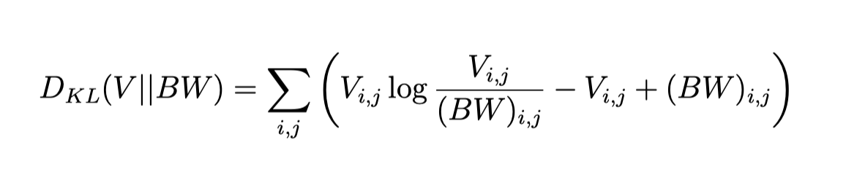
Finding Basis Matrix
For each source:
B with specific rank K where W is the activation matrix
Depending on results, each source has a specific K
drums: 40 bass: 20 vocals: 60 other: 90
Minimize this objective function based on KL divergence:
Notes:
Note various ranks for each B matrix
vocals and other have the most possibilities, so give them a larger rank
Note the minimization function
Hoang

Slide 19
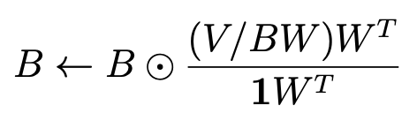
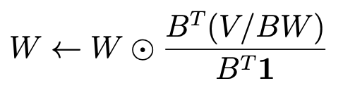
Solving Minimization Objective
Minimizing objective function results in multiplicative update:
Basis Matrix
Activation Matrix
Notes:
Here’s the multiplicative update!
Hoang

Slide 20
Decoupled Regularization and Multiplicative Updates
In separation phase, global dictionary is held constant
Goal: optimize W
Different acoustic characteristics
Targeted penalty functions
Notes:
Tom

Slide 21
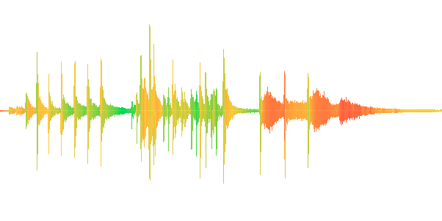
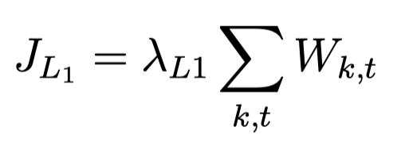
Custom Penalty Terms for Each Basis (Transient)
Drums: High L1 Sparsity Penalty
Capture the characteristic of the typical percussive transient of a drum hit.
Loud
full frequency response
fast attack
fast release
Notes:
Tom

Slide 22
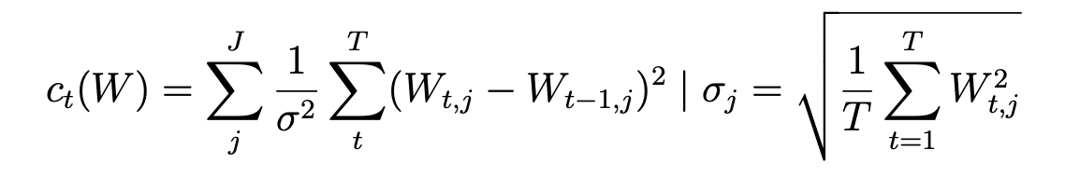
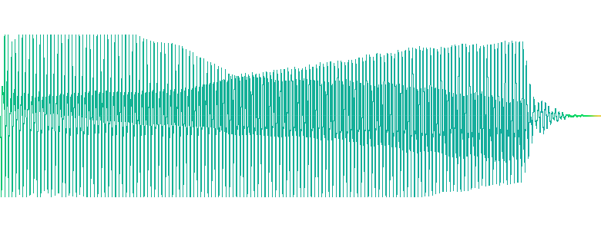
Custom Penalty Terms for Each Basis (Harmonic)
Temporal Continuity Penalty:
Produces consistent and smoother sounds over time
Frame to frame, any abuprut changes will be heavily penalized.
Notes:
Tom

Slide 23
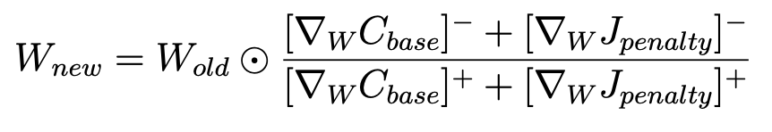
Custom Penalty Terms for Each Basis (Harmonic)
Conceptually minimizing this reduces difference between adjacent time frames
Results in modified Multiplicative update breaking it up between positive and negative components:
Notes:
Hoang

Slide 24
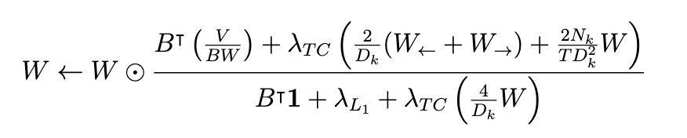
Formula
Notes:
Hoang

Slide 25
Interpreting Custom Penalties
Tuning hyperparameters individually:
low sparsity and low temporal continuity to vocals preserves jagged syllables
high sparsity to drums to correlate transient natures
Force algorithm to reject transience in harmonics and vice versa
Improves separation fidelity: analogous to keeping everything with their own type
Notes:
We tune each hyperparameter individually
Puts each type in it’s own bucket conceptually
Alex

Slide 26
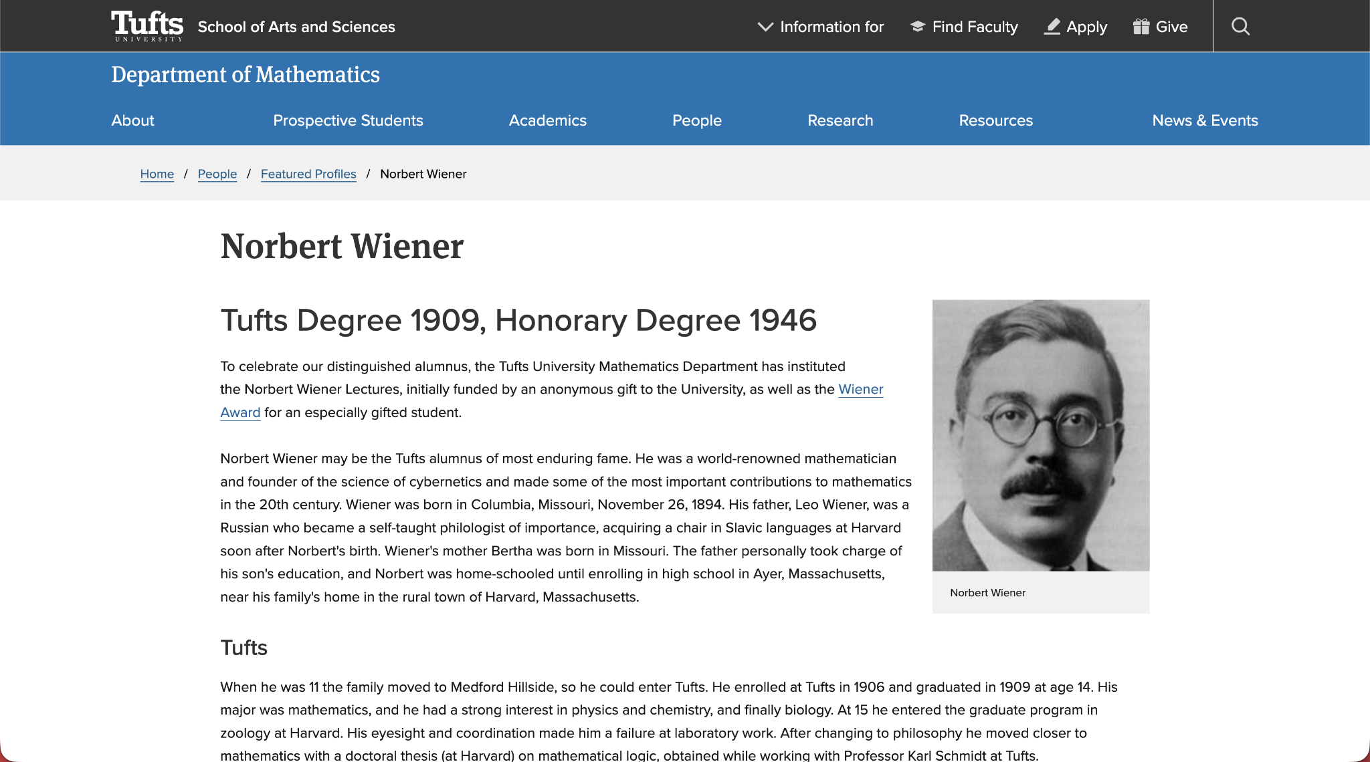
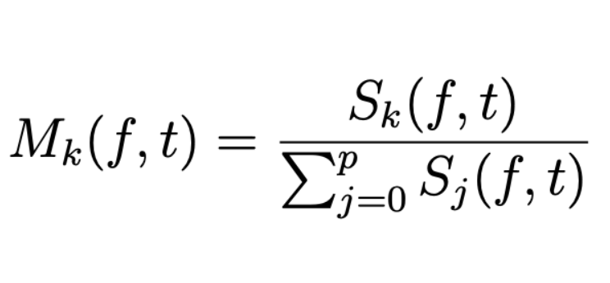
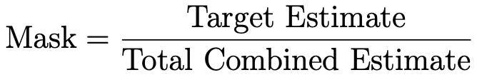
Phase Recovery: Soft Mask Wiener Filtering
Final raw NMF estimate V ≈ BW lacks phase information
iterative scheme on magnitude spectrogram
robotic audio if reconstructed directly
Solution: Wiener Filter
represents the proportional contribution of each instrument at every time-frequency bin
Fun Fact: Tufts Alumni
Notes:
Alex

Slide 27
Results
How do we assess if our output makes sense?
Examine how our activations / weights compare between instrument types
Quantify how accurate our reconstruction is
Notes:
Hoang

Slide 28
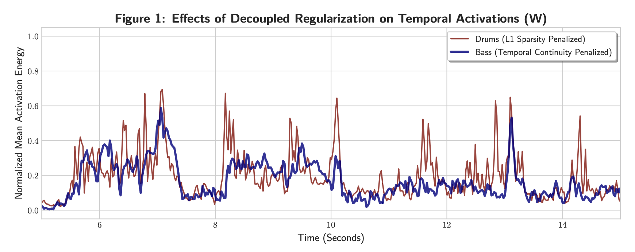
Results
Notes:
At least mention that we have audio separation.
Hoang

Slide 29
Results
Quantitative Performance Measures:
Blind Source Separation (BSS) Evaluation Toolkit:
Source-to-Distortion Ratio (SDR) Overall Quality
Source-to-Interference Ratio (SIR) Other Sound Suppression
Source-to-Artifact Ratio (SAR) Artifact Introduction
All in decibels (dB)
Notes:
SDR: Measures the overall quality of the separated audio. It calculates the power ratio between the intended source and all combined errors (interference, artifacts, and added noise). Higher is better.
SIR: Measures how well the algorithm suppresses other sound sources. For example, in a vocal extraction, it measures how much of the background music is still bleeding into the vocal track. Higher is better.
SAR (Source-to-Artifact Ratio): Measures the fidelity of the separated audio. It evaluates how many unwanted, unnatural digital "artifacts" (such as swooshing, phasing, or glitchy "musical noise") the separation process added to the original audio. Higher is better.
Alex

Slide 30
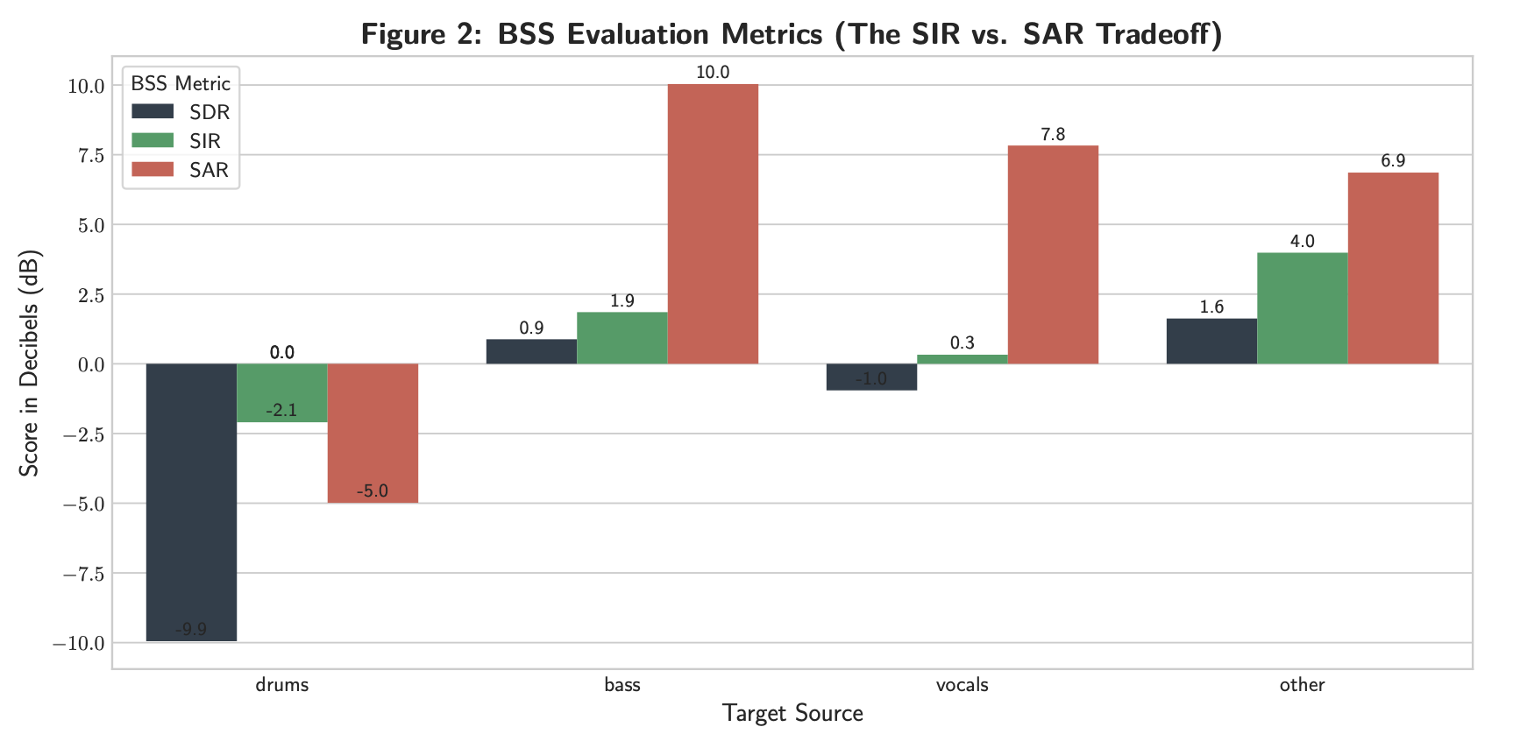
Notes:
NOTE: IT IS IMPORTANT WE TALK ABOUT DISCUSSION FOR THESE SLIDES. EXPLAIN WHAT THE GRAPHS MEAN AND WHAT WE’RE TAKING AWAY FROM THEM
TLDR: drums suck ass
each bar is evaluation matrix
black: overall
green: interference
red: amount of artificats
Alex

Slide 31
The Limits of the Current Pipeline
Hard-coding ranks for each stem basis
Prone to over capture or under capture an accurate representation for all basis
When two instruments overlap at the same frequency bin, using the mixed phase introduces interference in the isolated stems.
This coincidentally are the two shortfalls Tjao’s Harmonic Variable Sized Dictionary Learning address:
Dynamic dictionary sizing
Same time nearly frequency distinction and isolation.
In the future, A proposed hybrid Method could potentially solve this problem.
Notes:
Tom

Slide 32
Things to improve in the future
Utilizing Convolutional dictionary learning
Post Processing Clean up to improve Results.
Sigmoid / Tanh Filtering to help improve signal to noise ratio.
Spectral Erasing / De-bleed
Finding each instrument basis’ prominent spectral signature, and dimming those regions activation for other instruments to minimize source bleeding.
Implement MFCC as an indicator that aids source separation or as an dynamic adaptive envelope parameter.
Ex: Utilizes MFCC to calculate specific transient shape and tail to tailor drum isolation envelope.
Notes:
Tom

Slide 33
Thank You!
Questions?

